Slide 1
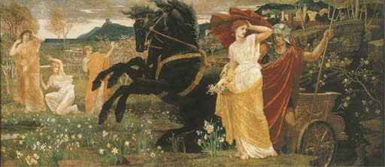
A TRUE TREASURE
Anglicanism & the Reformed Episcopal Church

Slide 2
A True Masterpiece
Brigham Bryant was just a ten-year-old school boy, but in 2002, he discovered a treasure. He had long admired the dusty oil painting hanging behind the librarian’s desk at his school in Old Lyme, Connecticut. It had hung there for 70 years without much notice.
One day he told his father about the painting. The description piqued his father’s interest so he went to see it for himself. Although dark and dingy from years of neglect, he discovered it to be a masterpiece by Walter Crane titled, The Fate of Persephone. Crane was a famous 19th century British artist and illustrator, particularly of children’s books.
This fixture in the school library turned out to be worth around one million dollars.
Source: British Weekly

Slide 3
I have learned over the past weeks that there are people in our congregation that have no idea that the Reformed Episcopal Church is part of the Anglican tradition. Those who opposed a previous rector back in the day accused him of being "Anglican" rather than being "Reformed Episcopal".

Slide 4
Questions
Q: When you hear the word Anglican, what comes to mind?
Q: Are you concerned about the use of the word Anglican
in relation to the Reformed Episcopal Church?
Q: If so, why? If not, why not?
What follows is a simple introduction to the relationship of the Reformed Episcopal Church to Anglicanism.

Slide 5
REC Constitution & Canons - ARTICLE III
Doctrinal Position
This Church holds the Faith as once delivered to the saints, and as transmitted through the Church of England, especially as articulated in her Reformation heritage, the range of her Anglican divines, and as deposited in the founding principles of the Protestant Episcopal Church in the United States of America.

Slide 6
Christianity was brought to the British Isles very early by Roman soldiers and traders. Tertullian, one of the earliest Latin Church Fathers, noted that as early as 220AD Christian groups were flourishing.
The name “Anglican” is traced back to the ancient Anglo-Saxon tribes of Europe who settled in Great Britian in the post-Roman period. The tribal name was spelled “Engles” or “Angles” and the tribe’s speech was the precursor to the English language. Their island became known as England. ("land of Ængle")

Slide 7
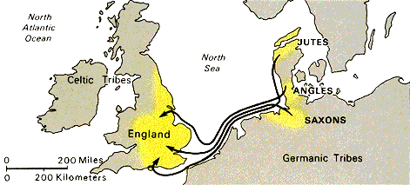

Slide 8
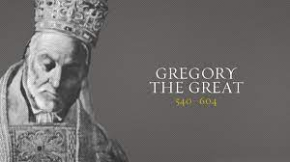
Timeline
209 – Execution of Alban
312 – Emperor Constantine
325 – Council of Nicaea
370 – British invasions
432 – Patrick
562 – Columba
590 – Pope Gregory I
597 – Augustine of Canterbury
663 – Synod of Whitby
670-1340 – Medieval Period

Slide 10
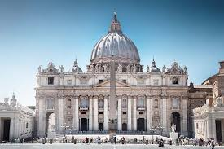
In 664 AD the Church in Britain consolidated and submitted to the bishop of Rome (the Pope) at the Synod of Whitby. The Church of Rome made the case that the church in the British Isles should become part of the Roman Church since it was the seat of St. Peter. After vigorous debate this view prevailed and would remain for nearly the next 1000 years.

Slide 11
Reformation
The Church of England and the Church of Rome separated in the 1500s during the Protestant Reformations. What happened?
The King’s Great Matter – Henry VIII & Catherine of Aragon
Pope Clement VII
Thomas Cranmer 1532
1533 Annulment
Act of Supremacy 1534
The English Reformation was a fairly conservative reformation, much like the Lutheran reforms. Both Lutheranism and Anglicanism kept more features and practices from the past than other types of Protestantism, such as vestments, the historic church calendar, and liturgical worship. The Church in England ended up with a solid biblical theology and the ancient ecclesiastical structure of Rome, less papal authority.

Slide 12
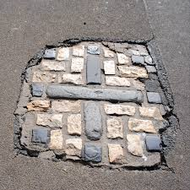
Timeline
1529 – Henry VIII
1532 – Thomas Cranmer
1549 – First Book of Common Prayer
1555 – Oxford Martyrs
1556 – Thomas Cranmer Executed
1563 – 39 Articles
1581 – Richard Hooker
1607 – Jamestown Settlement
1611 – King James Bible
1649 – Execution of Charles I (Oliver Cromwell)
1660 – Restoration of the Monarchy – Charles II
1662 – The Book of Common Prayer that is still the official version of the Church of England and is the Reformed Episcopal 2003 Book of Common Prayer version.

Slide 13
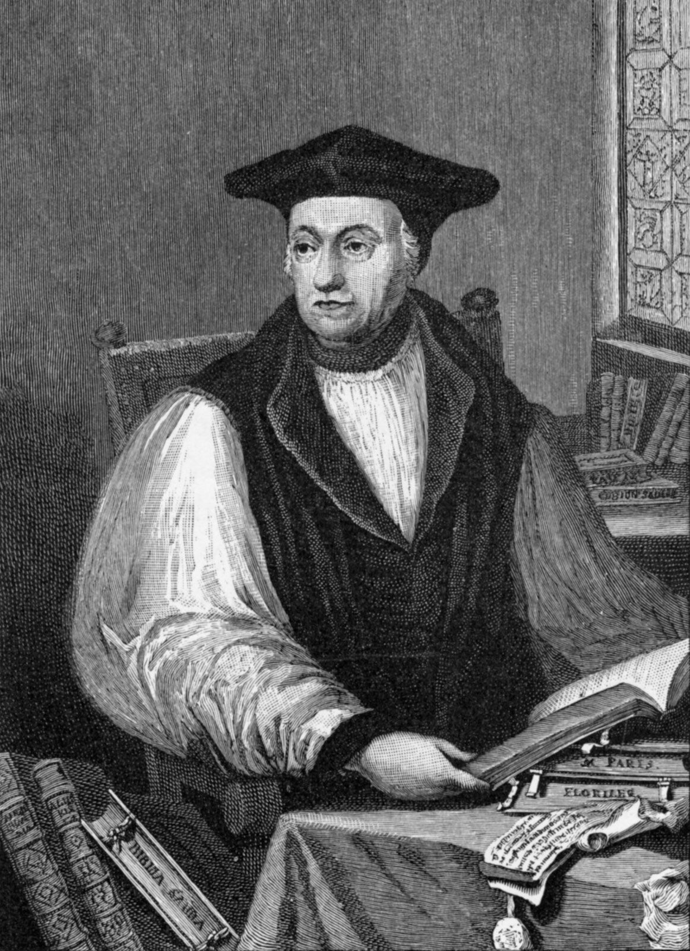
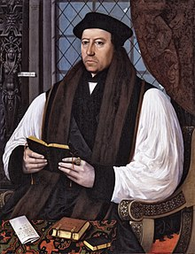
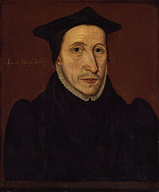
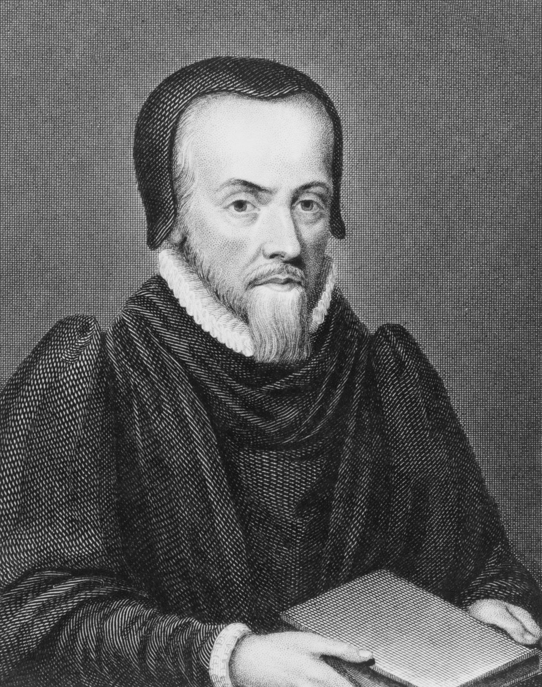
Early Anglican Divines
Archbishop Matthew Parker
(1504-1575)
Archbishop Thomas Cranmer
(1489-1556)
Bishop John Jewel
(1522-1571)
Rev. Richard Hooker
(1554-1600)

Slide 14
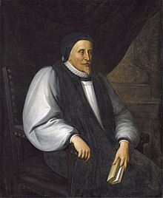
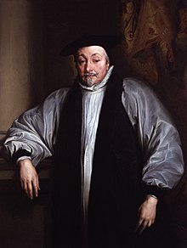
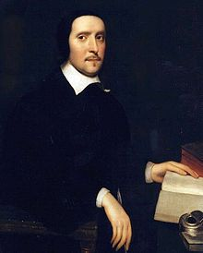
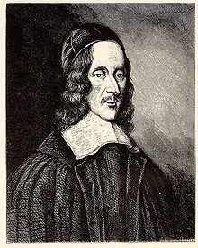
Caroline Divines
Bishop Lancelot Andrewes
(1555-1626)
Archbishop William Laud
(1573-1644)
Bishop Jeremy Taylor
(1613-1667)
Rev. George Herbert
(1593-1633)

Slide 15
Historical Cycles Summary
Ancient church in British Isles (209 & 220)
Council of Whitby (664)
Protestant Reformation (1534)
Romanism – Mary Tudor (1553)
Protestantism - Elizabeth I (1558) & James I (1603)
Puritans – Cromwell (1653)
Protestantism under Charles II (1660)

Slide 16
Restoration of the Monarchy – Charles II – 1660
Episcopal church government
39 Articles (law of prayer is the law of belief)
Book of Common Prayer
Normative principle of worship
Act of Uniformity – 1662
Theological stability
World-wide expansion – Colonialism & Mission

Slide 17
Protestant Episcopal
The Church of England went everywhere the British Empire went.
Virginia Colony in Jamestown – 1607
Massachusetts Bay Colony – 1628
Maryland Charter – 1632
By 1732 the original 13 colonies had been established
The American Revolution (1775-1783)

Slide 18
THE GENERAL CONVENTION (1784 – 1785)
Fundamental Principles
That there shall be a general Convention of the Episcopal Church in the United States of America.
That the Episcopal Church in each State, send Deputies to the Convention, consisting of Clergy and Laity.
That associated Congregations in two or more States, may send Deputies jointly.
IV. That the said Church shall maintain the Doctrines of the Gospel as now held by the Church of England; and shall adhere to the Liturgy of the said Church as far as shall be consistent with the American Revolution and the Constitutions of the respective States.

Slide 19
That in every State where there shall be a Bishop duly consecrated and settled, he shall be considered as a Member of the Convention, ex-Officio.
That the Clergy and Laity assembled in Convention, shall deliberate in one Body, but shall vote separately; and the Concurrence of both shall be necessary to give Validity to every Measure.
That the first Meeting of the Convention shall be at Philadelphia Tuesday before the Feast of St. Michael next; to which it is hoped and earnestly desired. That the Episcopal Churches in the respective States, will send their Clerical and Lay Deputies, duly instructed and authorized to proceed on the necessary Business here in proposed for their Deliberation.
Signed by Order of the Convention,
William Smith, D.D., President

Slide 20
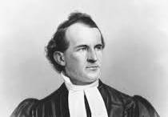
Anglicanism is a Western Christian tradition that has developed from the practices, liturgy, and identity of the Church of England following the English Reformation.
The Protestant Episcopal Church came out of the Church of England in 1785.
The Reformed Episcopal Church came out of the Protestant Episcopal Church and was formed in 1873.

Slide 21
The desire of our founding Bishop George David Cummins was to “restore the Old Paths”. In his letter of resignation to his Ordinary in the Protestant Episcopal Church he wrote: I have an earnest hope and confidence that a basis for the union of all Evangelical Christendom can be found in a communion which shall retain or restore a primitive Episcopacy and a pure scriptural liturgy, with a fidelity to the doctrine of justification by faith only…
God has brought the Reformed Episcopal Church into being for the purpose of revivifying the Anglican Communion. – The Rev. Joseph D. Wilson (7th General Council – 1879)
From the final paragraph of the REC Mission Statement: In this fashion, by embracing the broad base of doctrine and practice inherent in apostolic Christianity received by the Church of the English Reformation and expressed in the Thirty-nine Articles of Religion, the Reformed Episcopal Church has a foundation for effective ministry in the name of Christ to a world which is lost and dying without Him.

Slide 22
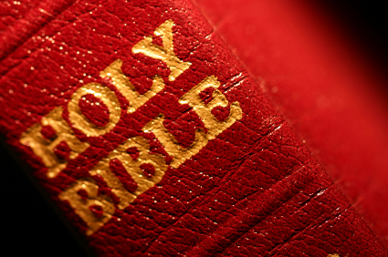
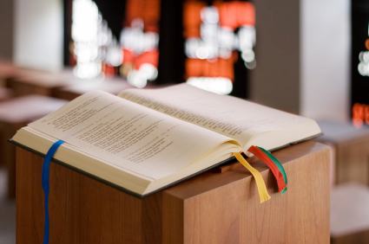
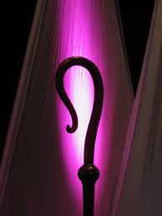
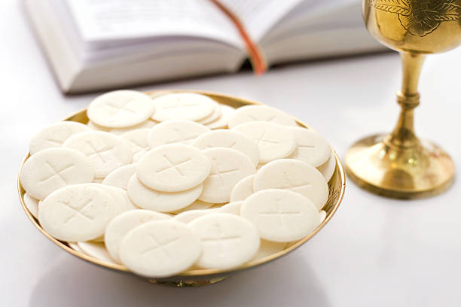
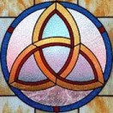
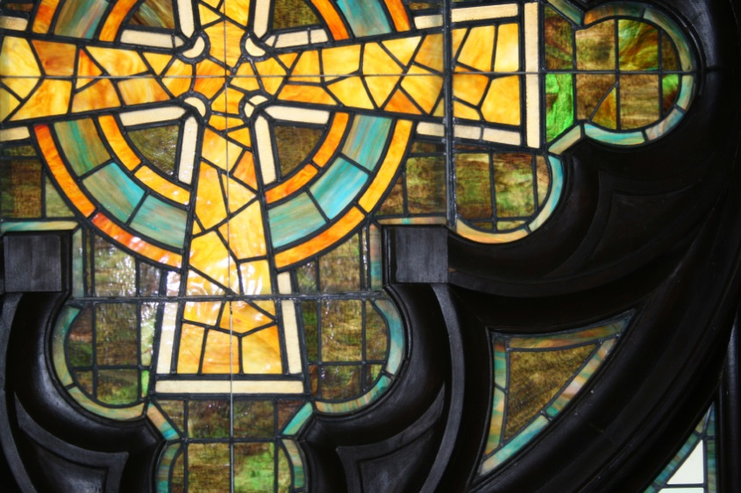

Slide 23
Anglican Realignment
The Reformed Episcopal Church became a founding jurisdiction of the Anglican Church in North America (ACNA) in 2009. The ACNA unites 134,000 Anglicans in 1,062 congregations across the United States, Canada, and Mexico into a single Church. In 2008 the Global Anglican Futures Conference (GAFCON) was convened. It was a world-wide gathering of biblical, orthodox Anglicans in Jerusalem. On April 16, 2009 ACNA was recognized as a province of the global Anglican Communion, by the Primates of GAFCON. The Jerusalem Declaration of 2008 came out of this meeting.

Slide 24
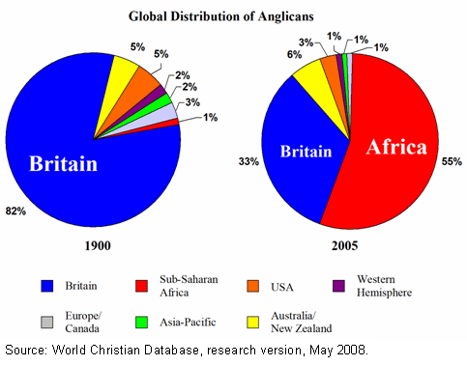

Slide 25
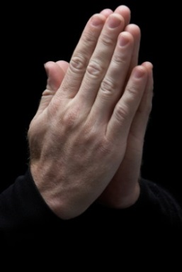
Conclusion
Do we understand and appreciate what the REC has to offer?
Our desire must be to build churches filled with people whose desire is to worship and serve the living God through faith in our Lord Jesus Christ. Being Anglican is a means to the end, not the end itself.
If we are to succeed in revitalizing this Diocese, it will only be because God blesses the work. Therefore, we will make prayer for the health and growth of our churches a regular part of every one of our diocesan meetings, our local worship services, parish meetings and the personal devotions of the people.

Slide 26
I have learned over the past weeks that there are people in our congregation that have no idea that the Reformed Episcopal Church is part of the Anglican tradition.
A TRUE TREASURE
Anglicanism & the Reformed Episcopal Church

Slide 27
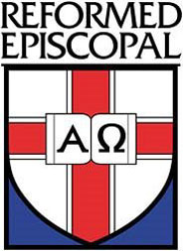
Questions?

